Slide 1
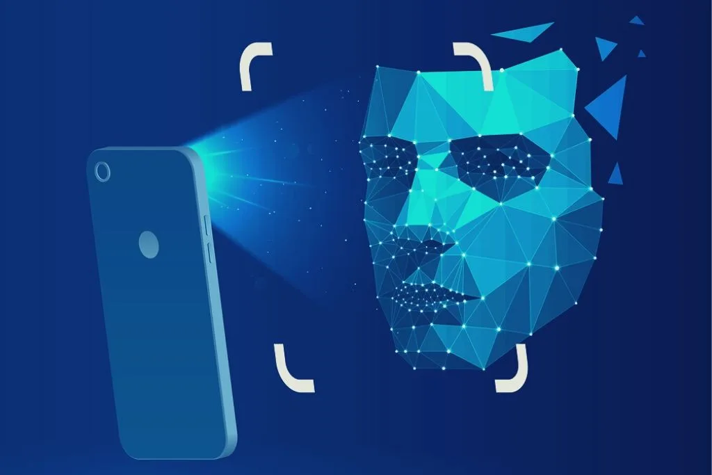
Final PROJECT TITLE:
FACE DETECTION & RECOGNITION BASED ATTENDANCE SYSTEM USING PYTHON

Slide 2
TEAM MEMBERS:
NAME | REGISTER NUMBER
SARATH KUMAR B | 111919104304
VASANTH M.M | 111919104305
SUBRAMANI.P.K | 111919104143

Slide 3
ABSTRACT:
The main purpose of this project is to build a face recognition-based attendance monitoring system for educational institution to enhance and upgrade the current attendance system into more efficient and effective as compared to before. The current old system has a lot of ambiguity that caused inaccurate and inefficient of attendance taking. Many problems arise when the authority is unable to enforce the regulation that exists in the old system. The technology working behind will be the face recognition system. The human face is one of the natural traits that can uniquely identify an individual. Therefore, it is used to trace identity as the possibilities for a face to deviate or being duplicated is low. In this project, face databases will be created to pump data into the recognizer algorithm. Then, during the attendance taking session, faces will be compared against the database to seek for identity. When an individual is identified, its attendance will be taken down automatically saving necessary information into a excel sheet. At the end of the day, the excel sheet containing attendance information regarding all individuals are mailed to the respective faculty.

Slide 4
INTRODUCTION:
The technology aims in imparting a tremendous knowledge oriented technical innovations these days. Deep Learning is one among the interesting domain that enables the machine to train itself by providing some datasets as input and provides an appropriate output during testing by applying different learning algorithms. Nowadays Attendance is considered as an important factor for both the student as well as the teacher of an educational organization. With the advancement of the deep learning technology the machine automatically detects the attendance performance of the students and maintains a record of those collected data. In general, the attendance system of the student can be maintained in two different forms namely,
Manual Attendance System (MAS)
Automated Attendance System (AAS).
KEYWORDS:-
Smart Attendance System, NFC, RFID, OpenCV, Numpy, LBPH(local binary pattern histogram)

Slide 5
PROBLEM STATEMENT:
According to the previous attendance management system, the accuracy of the data collected is the biggest issue. This is because the attendance might not be recorded personally by the original person, in another word, the attendance of a particular person can be taken by a third party without the realization of the institution which violates the accuracy of the data. For example, student A is lazy to attend a particular class, so student B helped him/her to sign for the attendance which in fact student A didn’t attend the class, but the system overlooked this matter due to no enforcement practiced. Supposing the institution establish enforcement, it might need to waste a lot of human resource and time which in turn will not be practical at all. Thus, all the recorded attendance in the previous system is not reliable for analysis usage. The second problem of the previous system is where it is too time consuming. Assuming the time taken for a student to sign his/her attendance on a 3-4 paged name list is approximately 1 minute. In 1 hour, only approximately 60 students can sign their attendance which is obviously inefficient and time consuming. The third issue is with the accessibility of that information by the legitimate concerned party. For an example, most of the parents are very concerned to track their child’s actual whereabouts to ensure their kid really attend the classes in college/school. However in the previous system, there are no ways for the parents to access such information. Therefore, evolution is needed to be done to the previous system to improve efficiency, data accuracy and provides accessibility to the information for those legitimate parties

Slide 6
EXISTING SYSTEMS:
Fingerprint Based recognition system:- In the Fingerprint based existing attendance system, a portable fingerprint device need to be configured with the students fingerprint earlier. Later either during the lecture hours or before, the student needs to record the fingerprint on the configured device to ensure their attendance for the day.
RFID (Radio Frequency Identification) Based recognition system:- In the RFID based existing system, the student needs to carry a Radio Frequency Identity Card with them and place the ID on the card reader to record their presence for the day. The system is capable of to connect to RS232 and record the attendance to the saved database
Iris Based Recognition System:- In the Iris based student attendance system, the student needs to stand in front of a camera, so that the camera will scan the Iris of the student.
Face Based Recognition System:- The facial recognition technology can be used in recording the attendance through a high-resolution digital camera that detects and recognizes the faces of the students and the machine compares the recognized face with students’ face images stored in the database.

Slide 7
PROPOSED SYSTEM:
The task of the proposed system is to capture the face of each student and to store it in the database for their attendance. The face of the student needs to be captured in such a manner that all the feature of the students' face needs to be detected. There is no need for the teacher to manually take attendance in the class because the system records a video and through further processing steps the face is being recognized and the attendance database is updated. This system is developed using python OpenCv.
OpenCV (Open Source Computer Vision Library)
Image Capture
Image Processing
Convolution Neural Network

Slide 8
LITERATURE SURVEY:
A Counterpart Approach to Attendance and Feedback System using Machine Learning Techniques | Automated Attendance System Using Face Recognition | Student Attendance System Using Iris Detection | Face Recognition-based Lecture Attendance System
YES | YES | MAYBE(partially) | NO

Slide 9
REQUIREMENTS:
HARDWARE REQUIREMENT:
WINDOWS OPERATING SYSTEM (like winsXP, win7 or basically LINUX, UBUNTU etc.)
At least INTEL PENTIUM PROCESSOR
RAM above 1GB and HDD above 250GB(with video card)
OFTWARE REQUIREMENT:
PYTHON3.9 or above
openCV 2.3 or above
installing packages like cv2, opencv, face recognition, pillow, pandas, tktools, tkinter, numpy

Slide 10
ALGORITHMS IN FACE RECOGNITION:-
Convolutional Neural Network (CNN)
Eigenfaces
Fisherfaces
Kernel Methods: PCA and SVM
Haar Cascades
Three-Dimensional Recognition
Skin Texture Analysis
Thermal Cameras
ANFIS
Local Binary Patterns Histograms (LBPH)
FaceNet
NEC
Megvii (Face++)
*NOTE:- WE CURRENTLY USE LBPH ALGORITHM*

Slide 11
METHODOLOGY:-
Before the attendance management system can work, there are a set of data needed to be inputted into the system which essentially consist of the individual’s basic information which is their ID and their faces. The first procedure of portrait acquisition can be done by using the Camera to capture the faces of the individual. In this process the system will first detect the presence of a face in the captured image, if there are no face detected, the system will prompt the user to capture their face again until it meets certain number of portraits which will be 10 required portraits in this project for each student. The decision of storing only 10 portrait per student is due to the consideration of the limited storage space in the raspberry pi because the total amount of students in the university is considered heavy. Then, the images will undergo several pre-processing procedures to obtain a grayscale image and cropped faces of equal sized images because those are the prerequisites of using the Eigen Faces Recognizer.

Slide 12
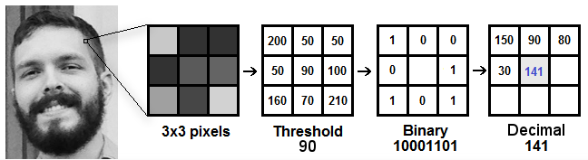
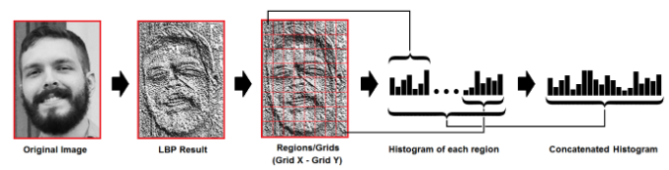
RESULTS USING LBPH ALGORITHM:

Slide 13
Conclusion:
Before the development of this project. There are many loopholes in the process of taking attendance using the old method which caused many troubles to most of the institutions. Therefore, the facial recognition feature embedded in the attendance monitoring system can not only ensure attendance to be taken accurately and also eliminated the flaws in the previous system. By using technology to conquer the defects cannot merely save resources but also reduces human intervention in the whole process by handling all the complicated task to the machine. The only cost to this solution is to have sufficient space in to store all the faces into the database storage. Fortunately, there is such existence of micro SD that can compensate with the volume of the data. In this project, the face database is successfully built. Apart from that, the face recognizing system is also working well. At the end, the system not only resolve troubles that exist in the old model but also provide convenience to the user to access the information collected by mailing the attendance sheet to the respected faculty.

Slide 14
REFERENCE:-
[1]. “Attendance System Using NFC Technology with Embedded Camera on Mobile Device” (Bhise, Khichi, Korde,Lokare, 2015)
[2]. K.SenthamilSelvi, P.Chitrakala, A.AntonyJenitha, "Face Recognition Based Attendance Marking System", IJCSMC, Vol. 3, Issue. 2, February 2014.
[3]. “Fingerprint Based Attendance System Using Microcontroller and LabView” (Kumar Yadav, Singh, Pujari, Mishra, 2015)
[4]. “RFID based Student Attendance System” (Hussain, Dugar, Deka, Hannan, 2014)
[5]. OpenCvDocumentation -https://opencv.org
[6]. Numpy - https://numpy.org

